Slide 1
i
dentity

Slide 2

Make collaboration in BIM
like
collaboration in Software Development

Slide 3
Data Set 1
Data Set 2
Data Set 3

Slide 4
Connection instead of Conversion

Slide 5


Slide 6


Slide 7
Technology

Slide 8
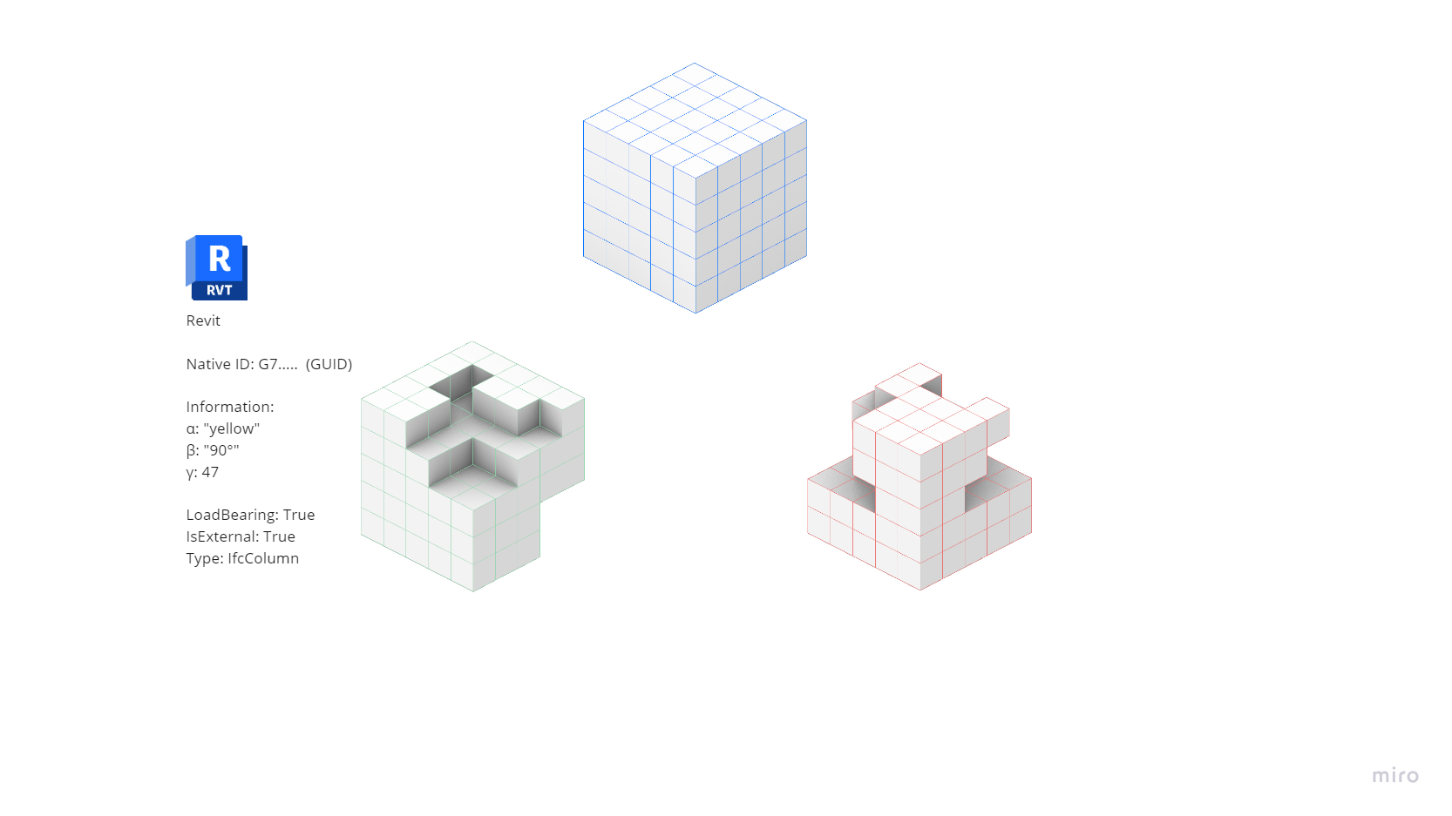
SLIDE ELLIA

Slide 9
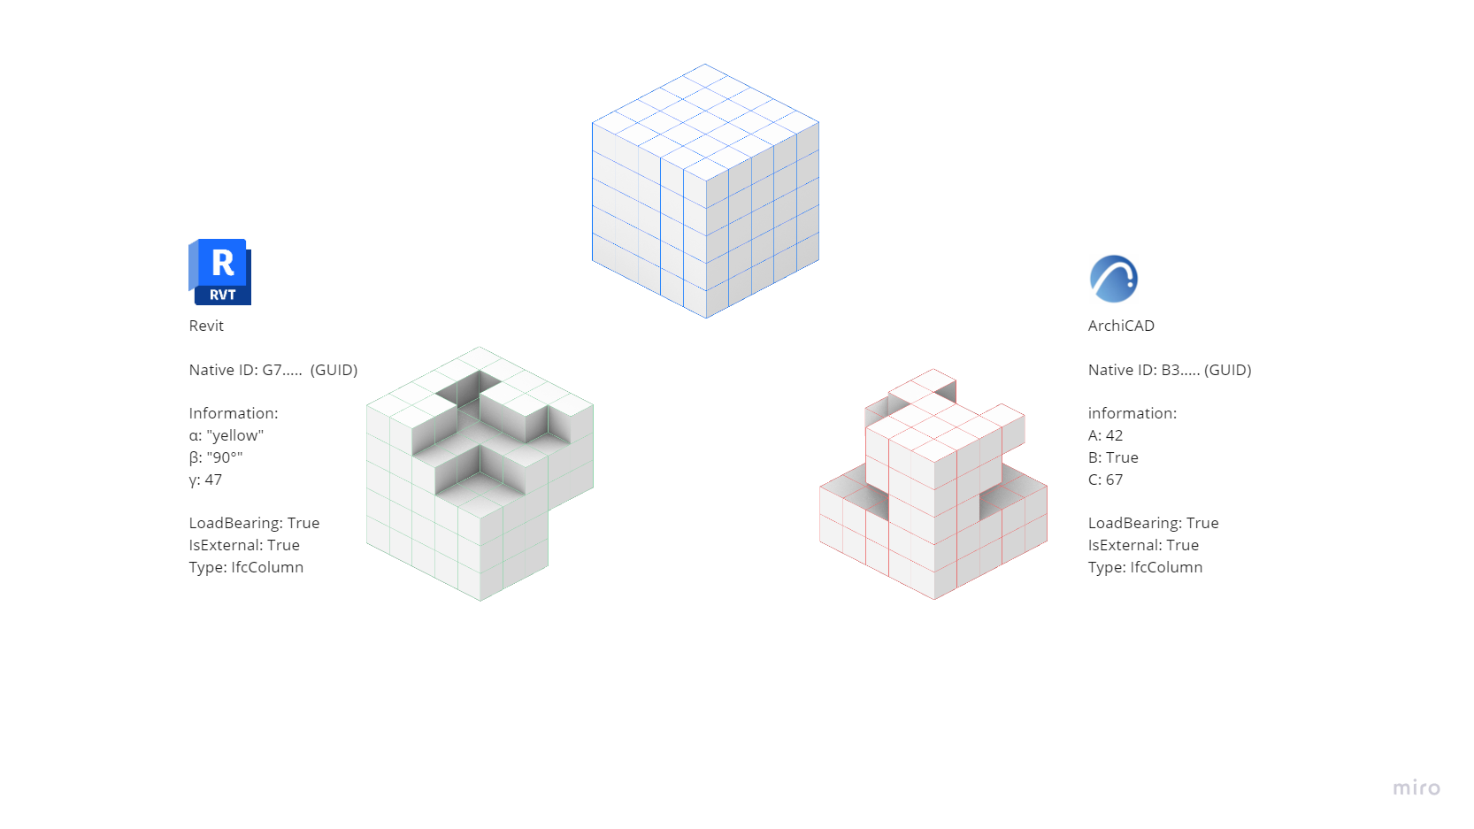

Slide 10
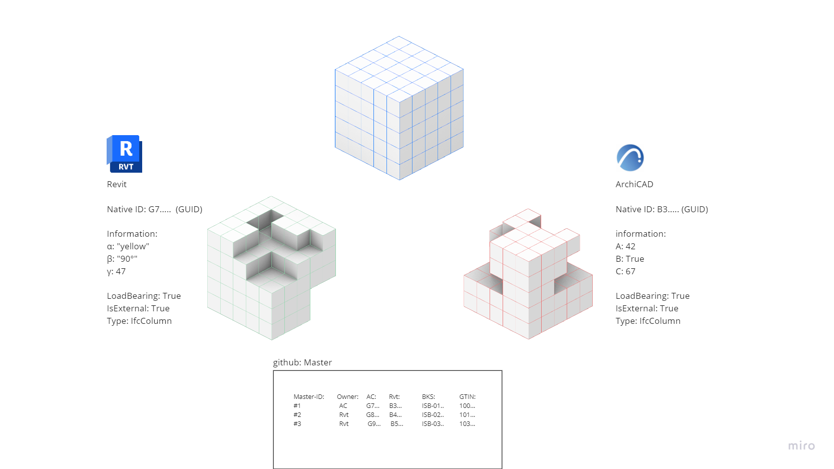
SLIDE ELLIA

Slide 11
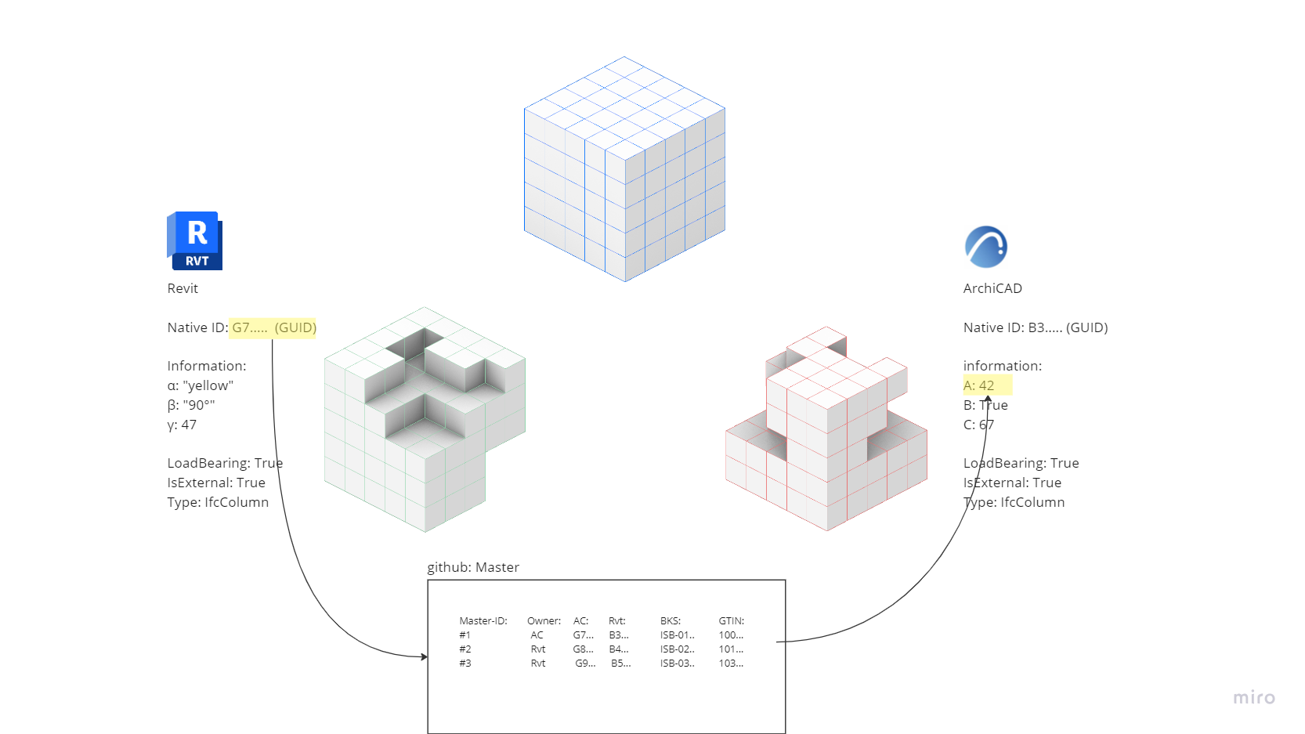
SLIDE ELLIA

Slide 12
Principles
Show information in native software
BUT don’t touch the interal workflow
Need to specify where data originates
Need to quickly detect changes
Should work with free / existing tools
Should be able to be viewed

Slide 13
Challenges
Two files might talk about the same thing, but have different IDs
Relevant data about entities is in different design documents
Multiple geometry representations exist (and are valid)
2D or 3D
Level of detail: Fine, Medium, or Coarse
Tessellation algorithm in geometry kernel
Merging entities when geometric representations are similar
Need to make data changes easily seen in “diff” tools

Slide 14
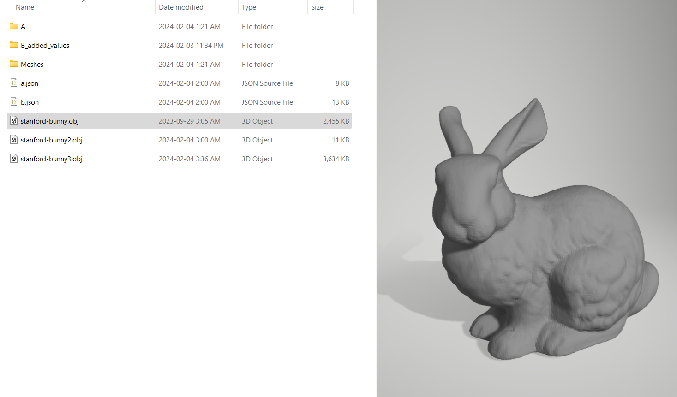
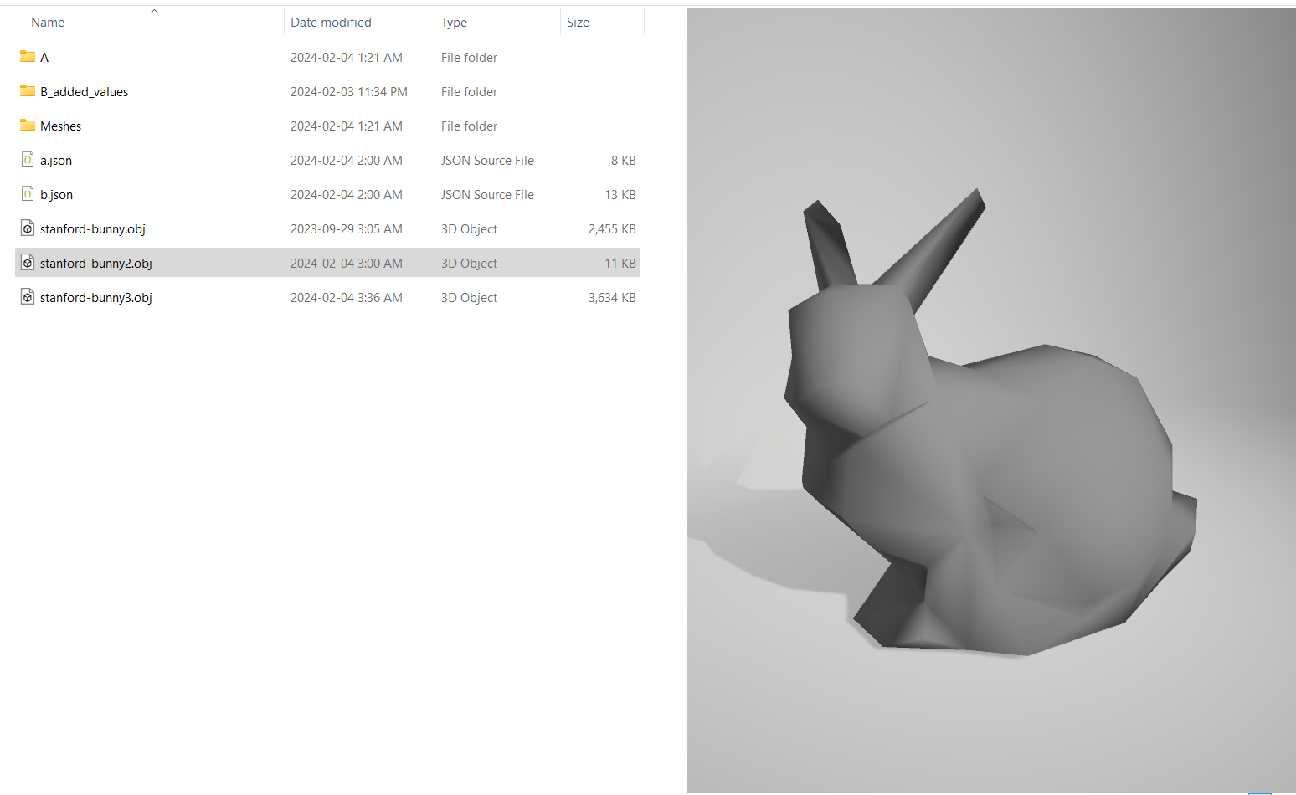
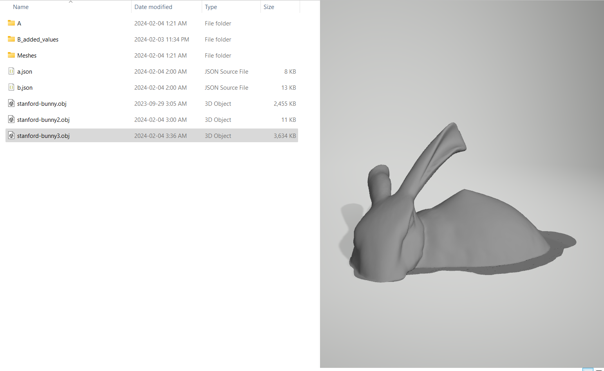
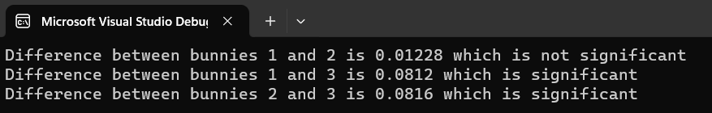
Mesh Similarity Challenge
How do we determine if two meshes are similar?
For each point in mesh A, find distance to B (vice versa)
Take the maximum
Compare to a tolerance
Used g3Sharp by Ryan Schmidt

Slide 15
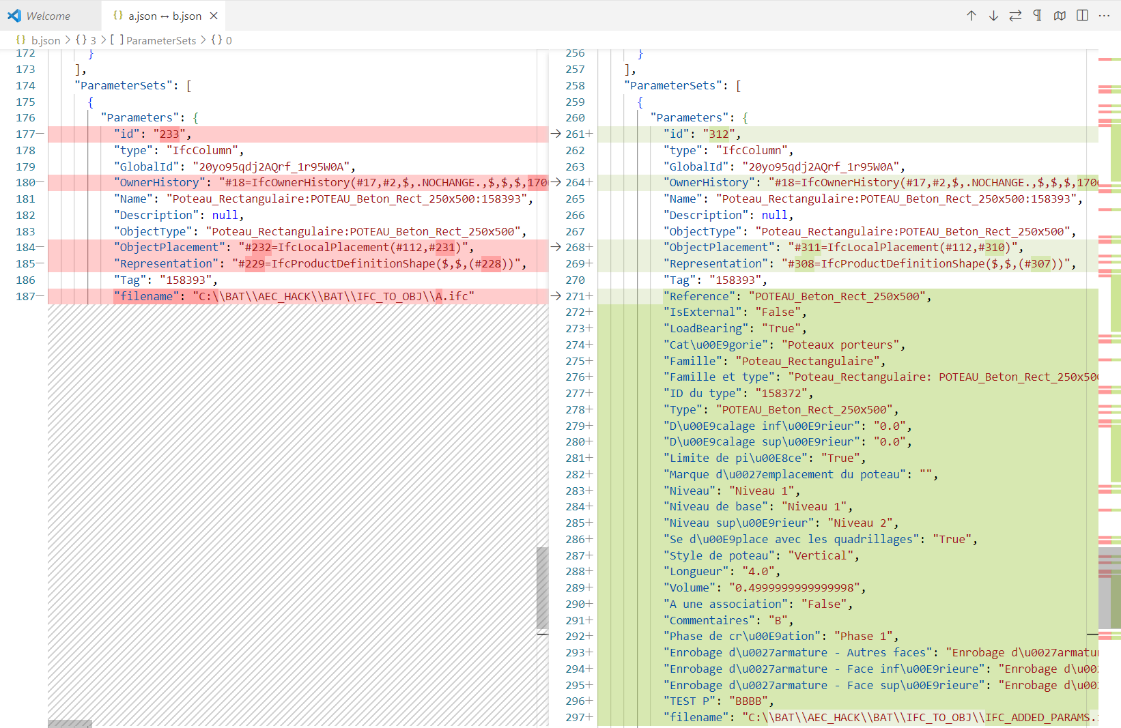
Json Representation of Identity Model

Slide 16
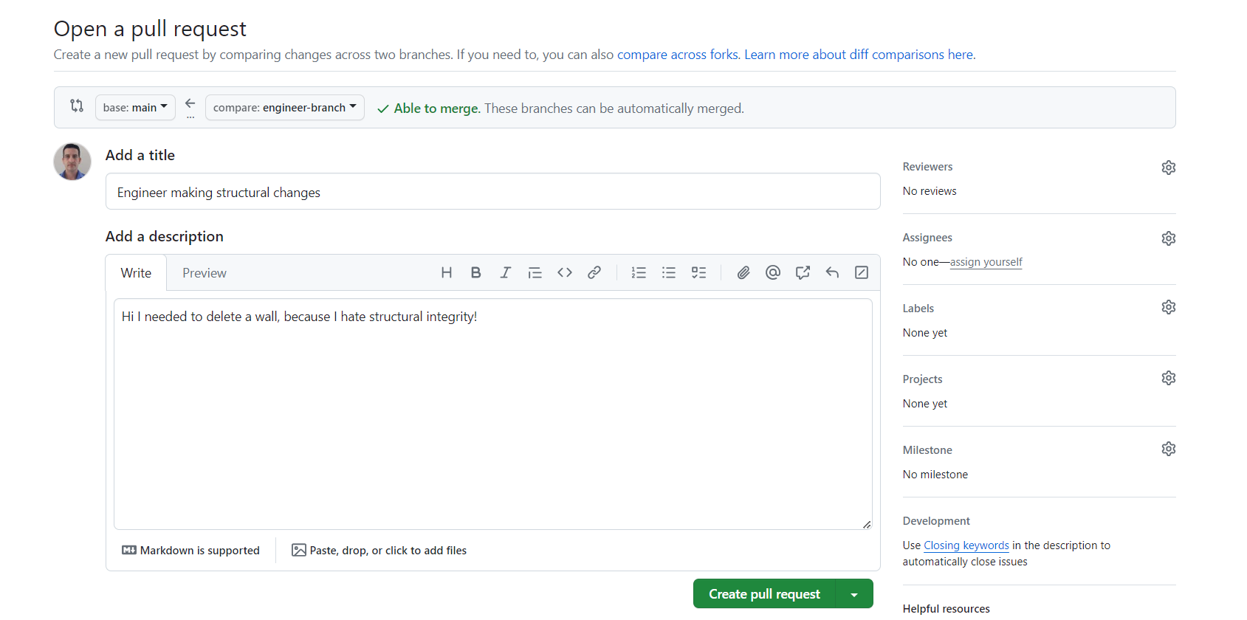
Git Workflow – Create “Pull Request”

Slide 17
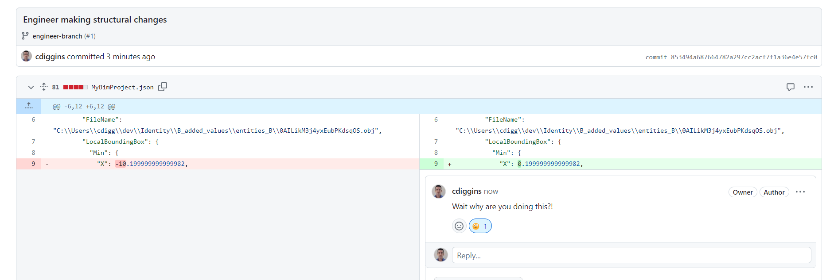

Slide 18
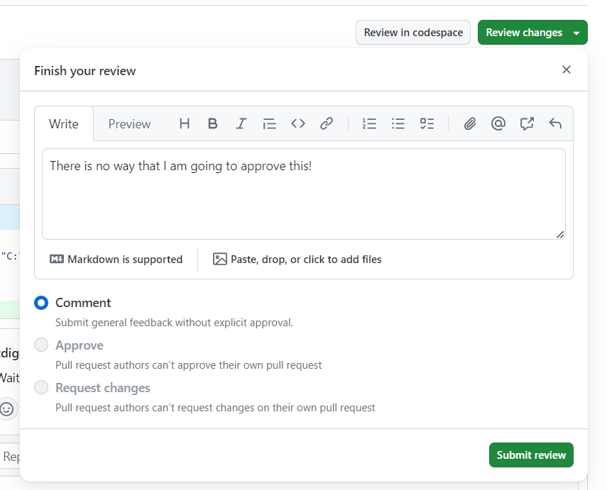
Approve / Reject Online using Github!

Slide 19
Make collaboration
native and easy

Slide 20
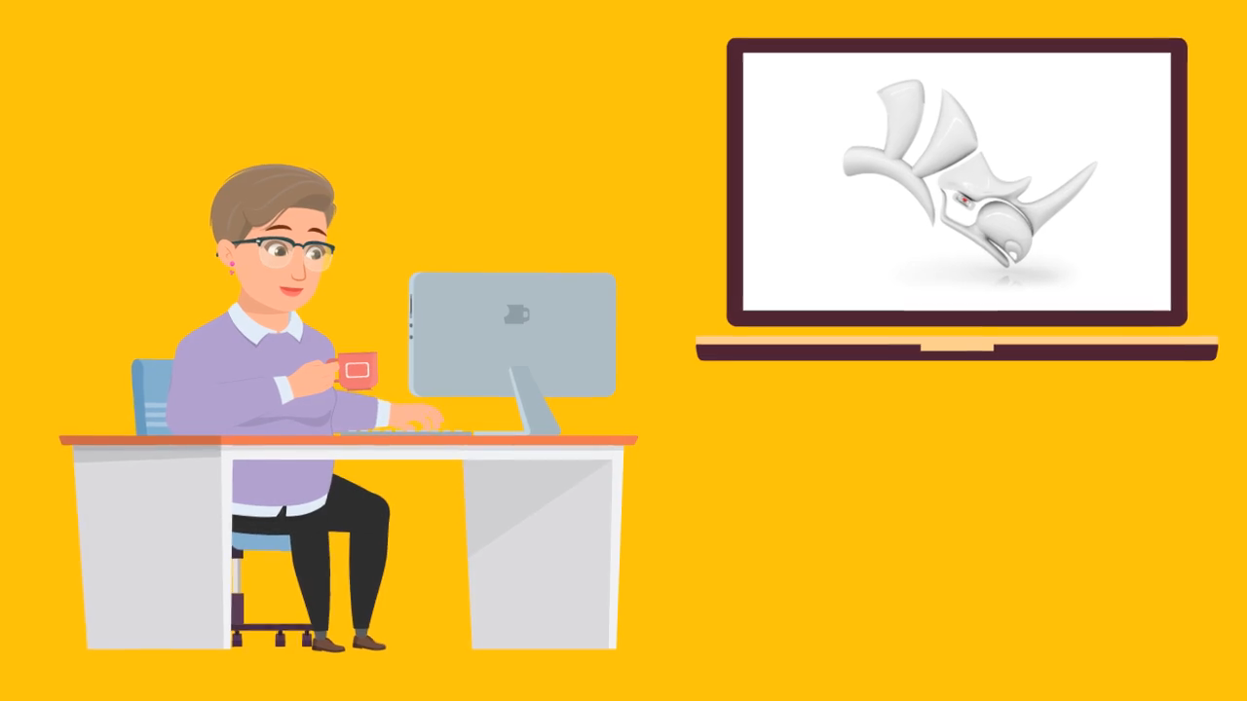

Slide 21

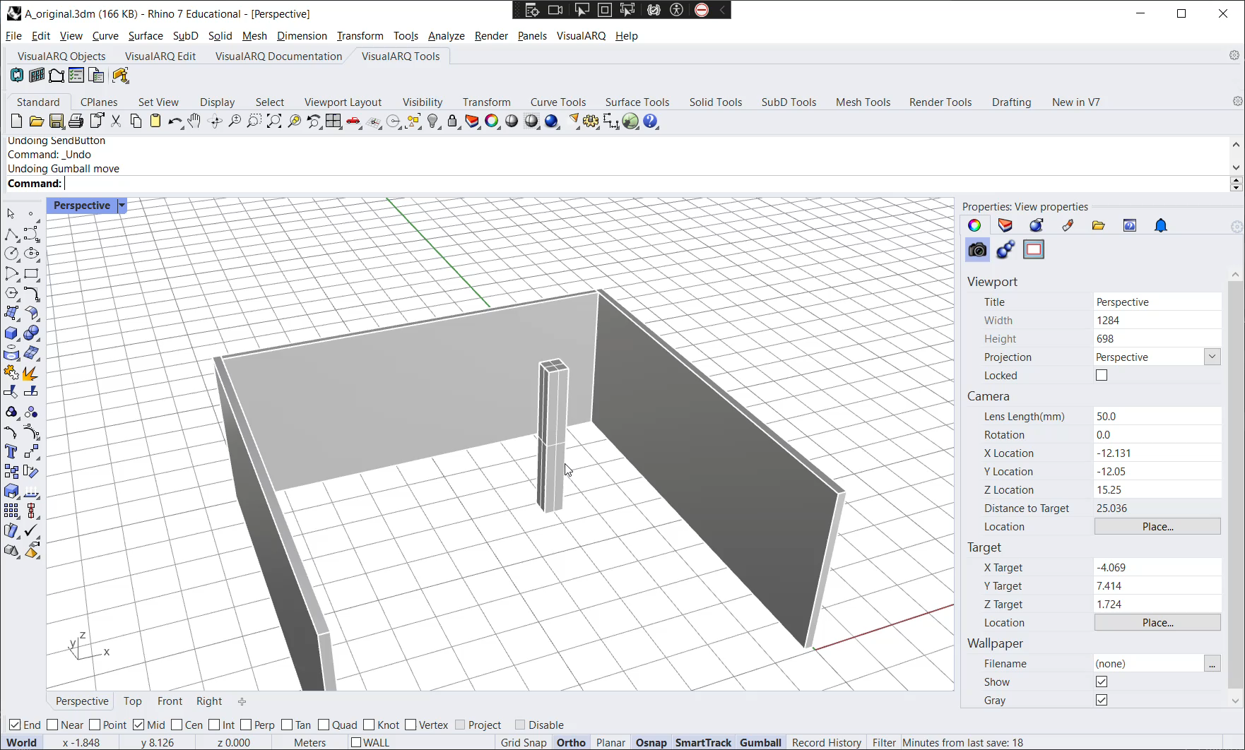

Slide 22


Slide 23
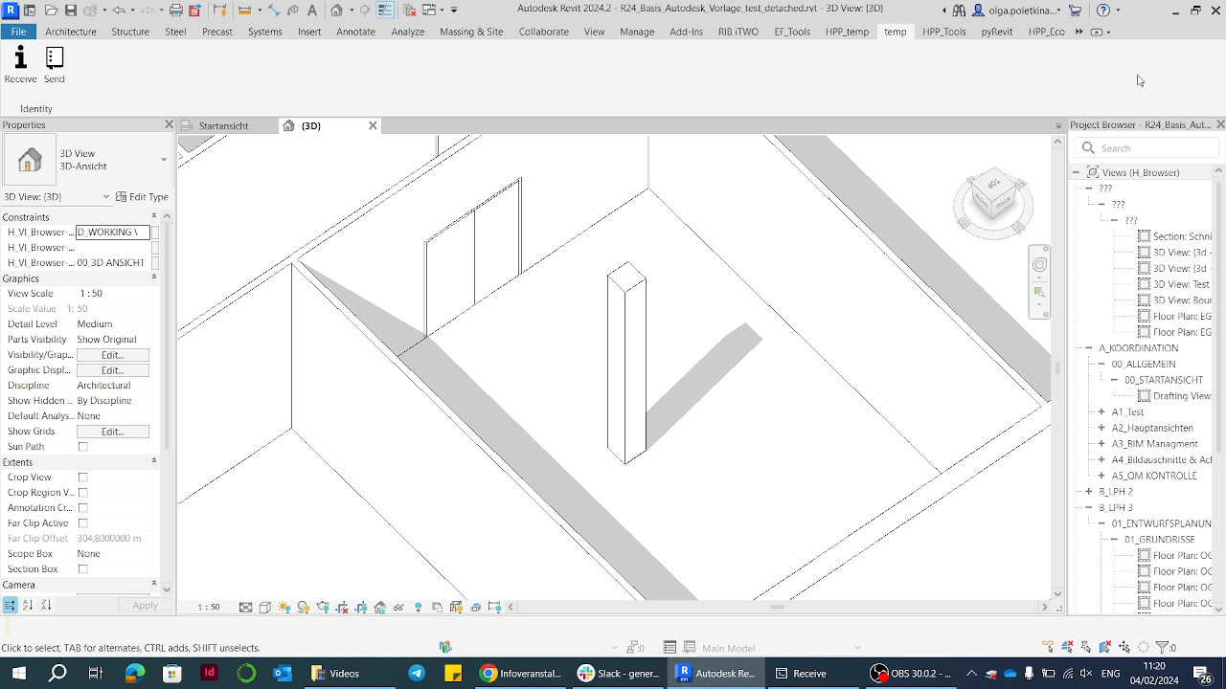

Slide 24
Thank´s for listening
We are Ahmed, Christopher, Elia, Helena, Mohamad, Olga and Otmane

